Slide 1


RESULTIFY
A Full Stack Student Result Management Web Application.
1

Slide 2

OBJECTIVE
The current project aims at creating a web-based student result management system, reducing time, effort and improving security. The methodology adopted for the elaboration of the project is based on qualitative study. The project results in the development of a multi-user system, based on web technology with MVC architectural pattern and developed using HTML , CSS , PHP , Javascript and Bootstrap Framework.

Slide 3

PROBLEM STATEMENT
The education system is undeniably the backbone of the society, it focuses at preparing the young talents for the future.
However, currently the process of students’ result management and declaration is performed manually with extensive human intervention. The student’s results are generated
through a spreadsheet application and then printed on a paper, attached to a wall for declaration and then stored.

Slide 4

SOLUTION
The project aims at developing and implementing a web-based student result management system, replacing the old manually done paper work and to minimize .The security issues and the problems it possesses. The computerization of the current system will have an impact on the way the students access their results and, how it is managed and generated by the institution’s employees. The system will make the life much easier for the institution as they will be able to store data much better than how they were able to do earlier.

Slide 5












TOOLS USED :
HTML
CSS
JAVASCRIPT
PHP
BOOTSRAP V.4.3 FRAMEWORK
OTHER TOOLS :
MySQL database
Wamp Server
Google Chrome
Microsoft Visual Studio Code
5

Slide 6


FEATURES :
• User friendly, intuitive design and self-explanatory functionalities;
• Adequacy for the users’ levels of experience and knowledge;
• High system robustness against data-loss or system failure;
• High data security standards;
• Easy accessibility;
• System flexibility for institutions’ individual configurations and concept adaptations.
Students can checkout their results after entering USN in the login page.Results can also be downloaded as pdf or printed it out.
Result Maintainers / Staff / Faculty can manage and maintain student's result by loggin in with an authorized username and password.
Results can be added , edited and deleted as per user's requirement.
A search box to implement faster access to a specific record which could be usn-wise, department-wise or semester wise.
6

Slide 7

Student Login View
Preview of the application

Slide 8
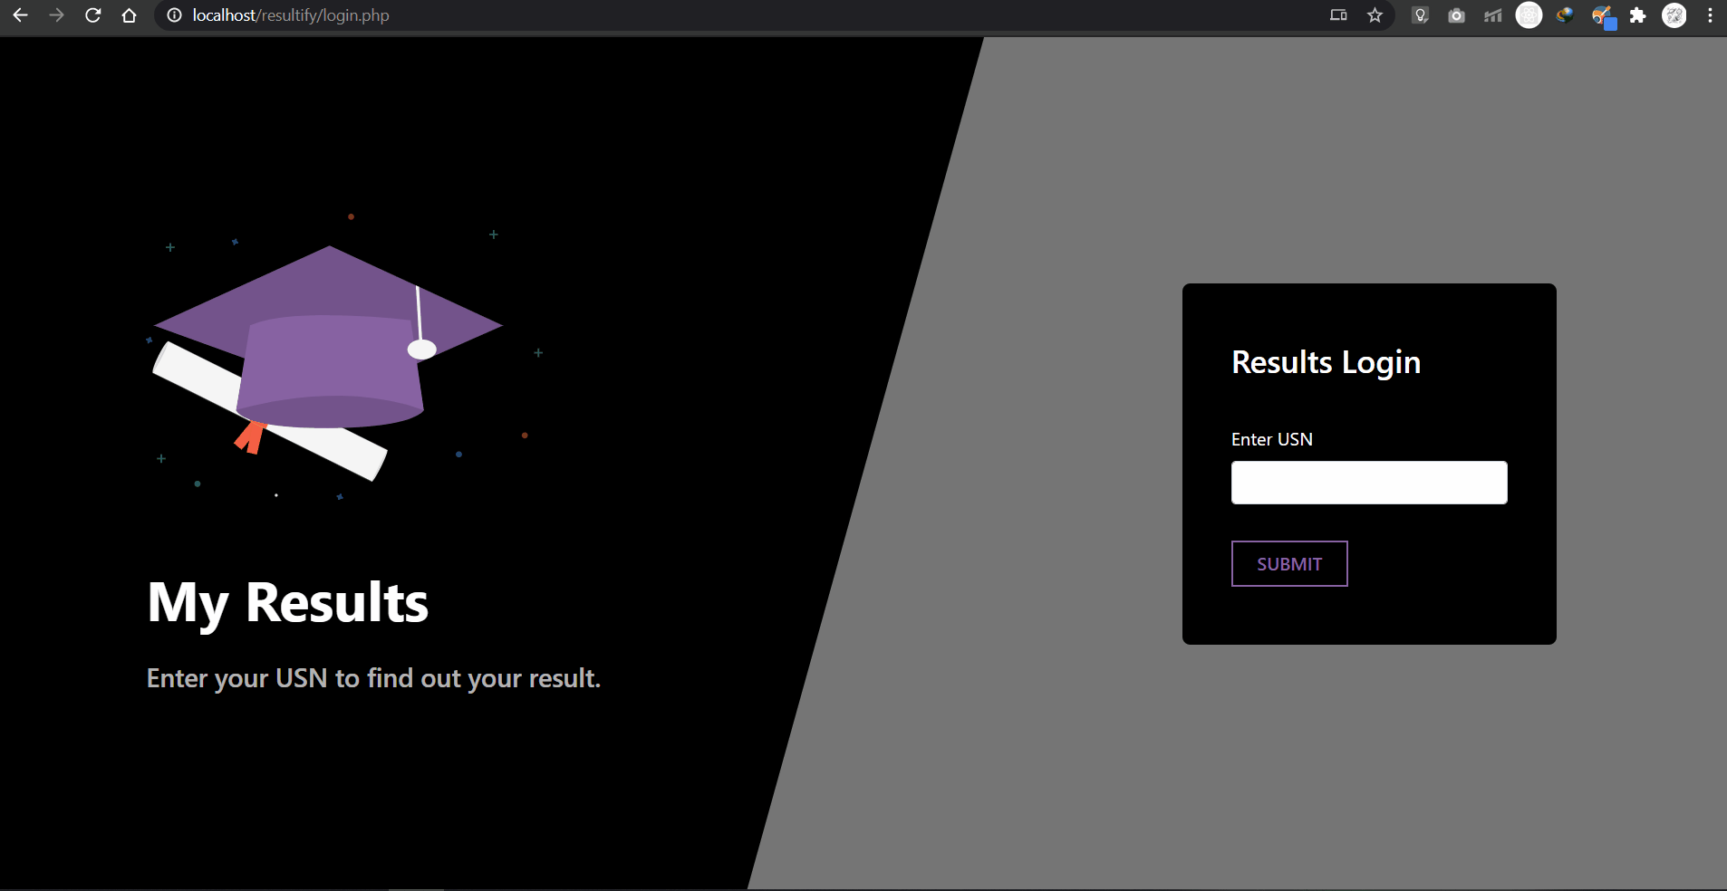

Slide 9
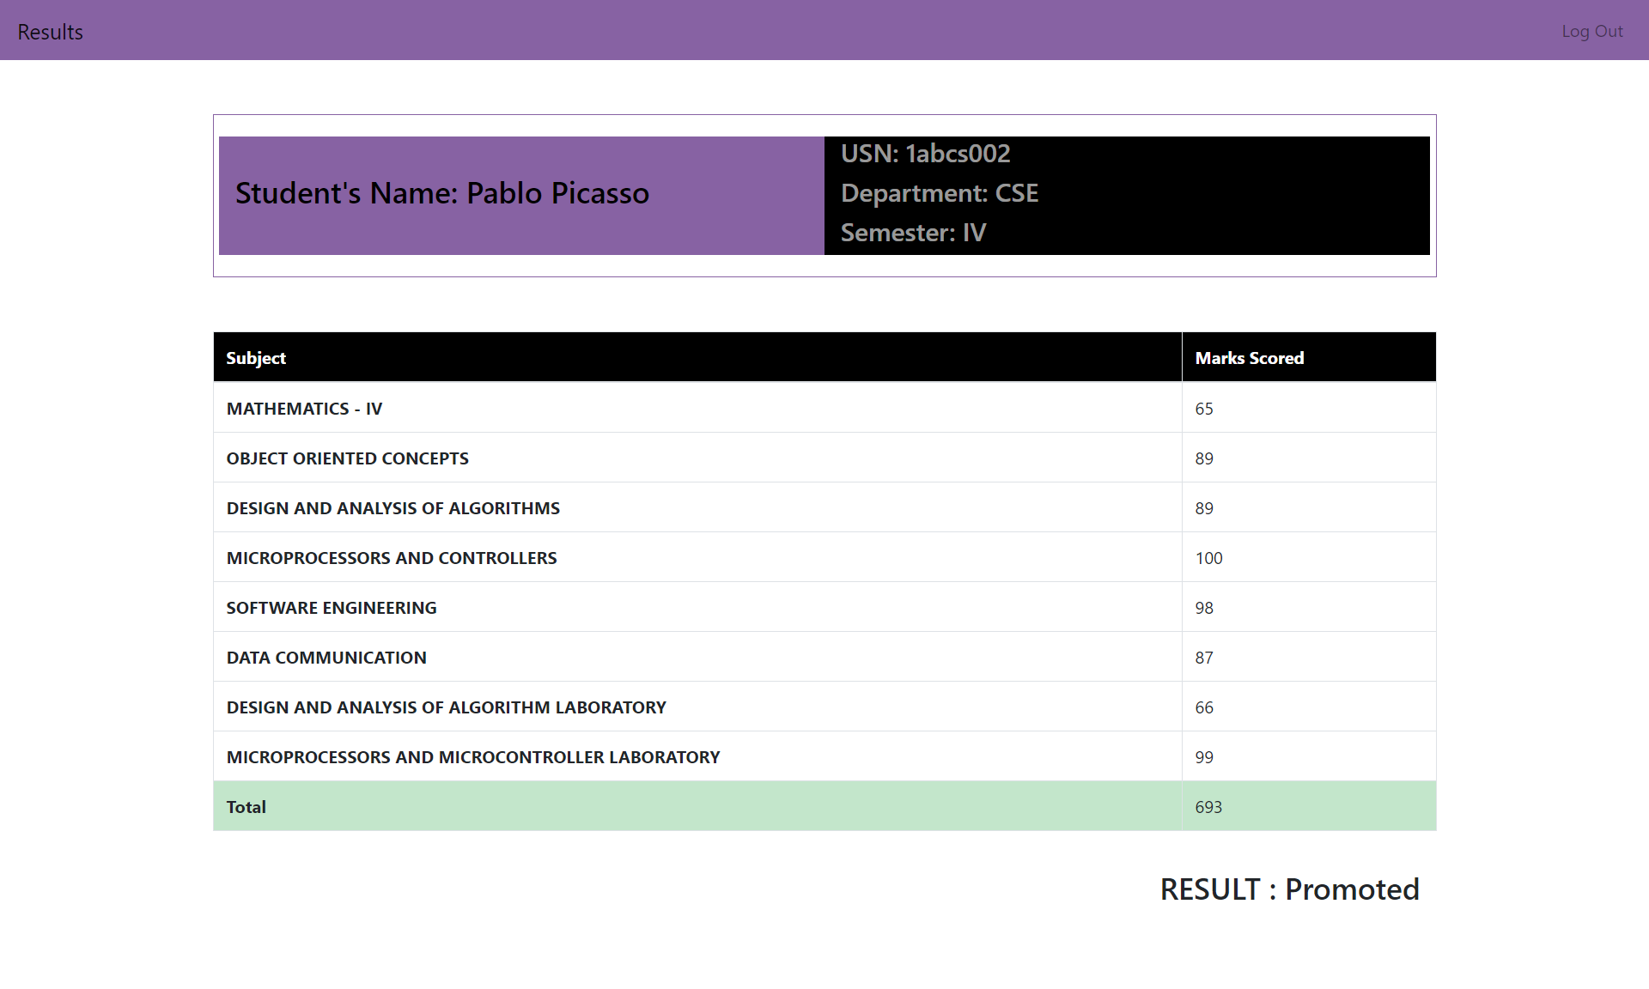

Slide 10


FACULTY / MAINTAINER LOGIN VIEW
Preview of the application.
10

Slide 11
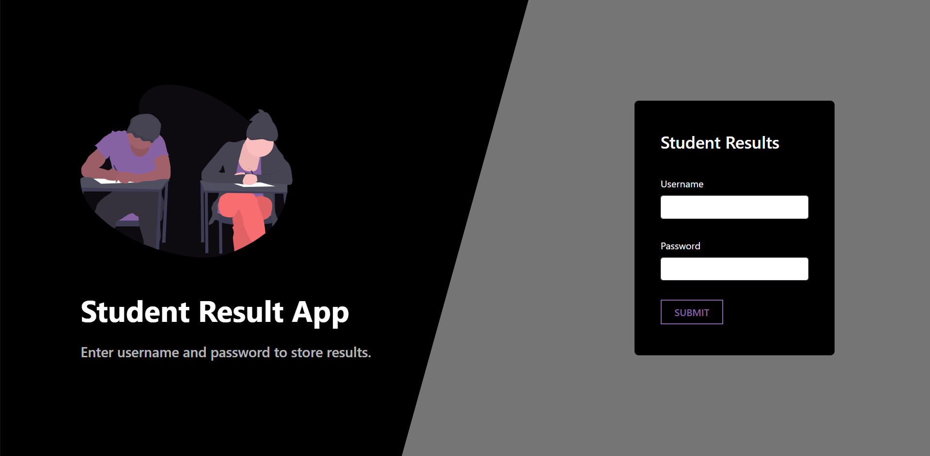

Slide 12
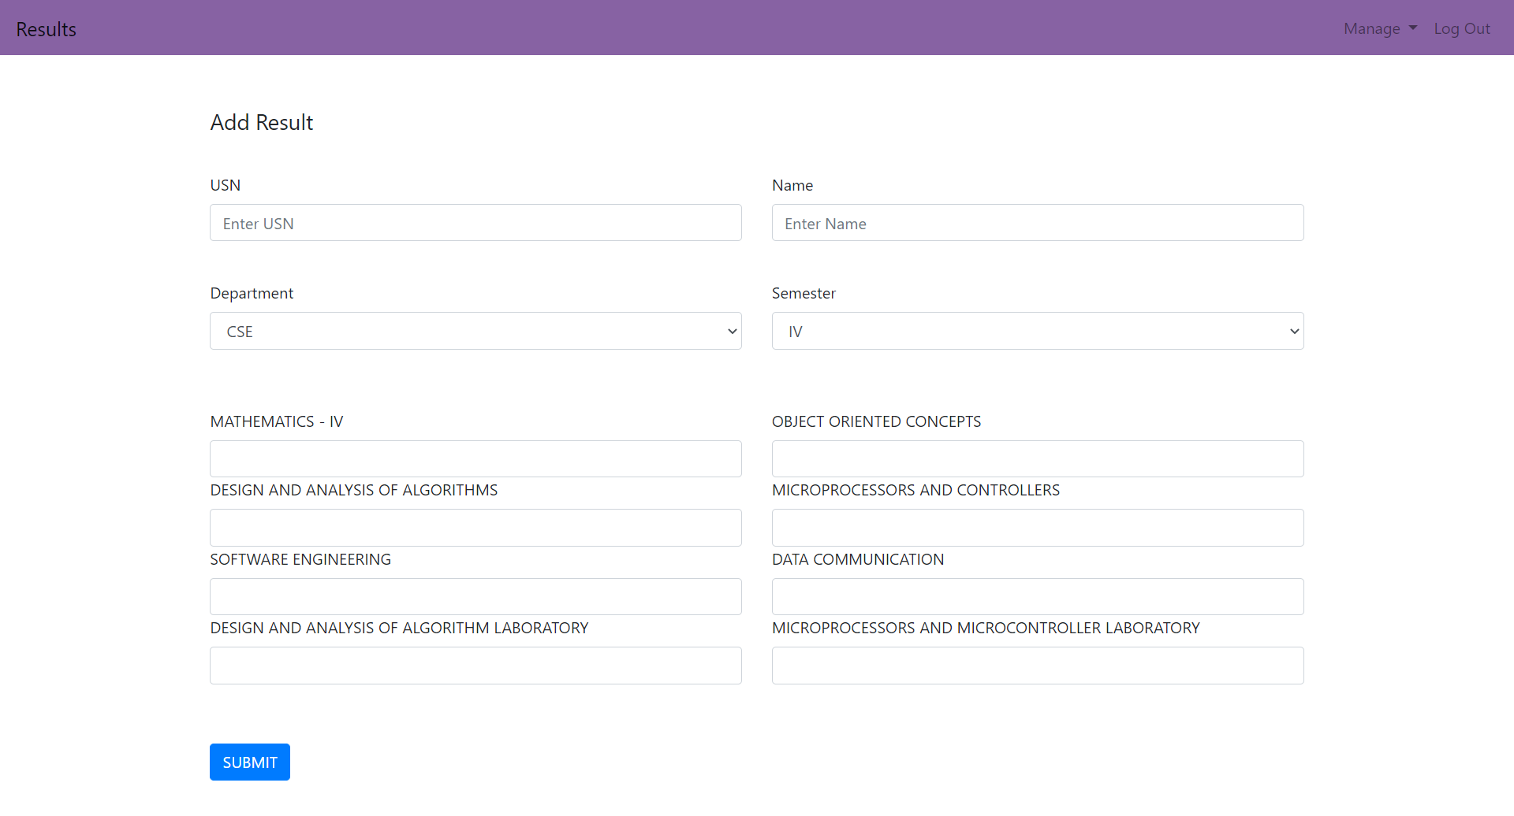

Slide 13
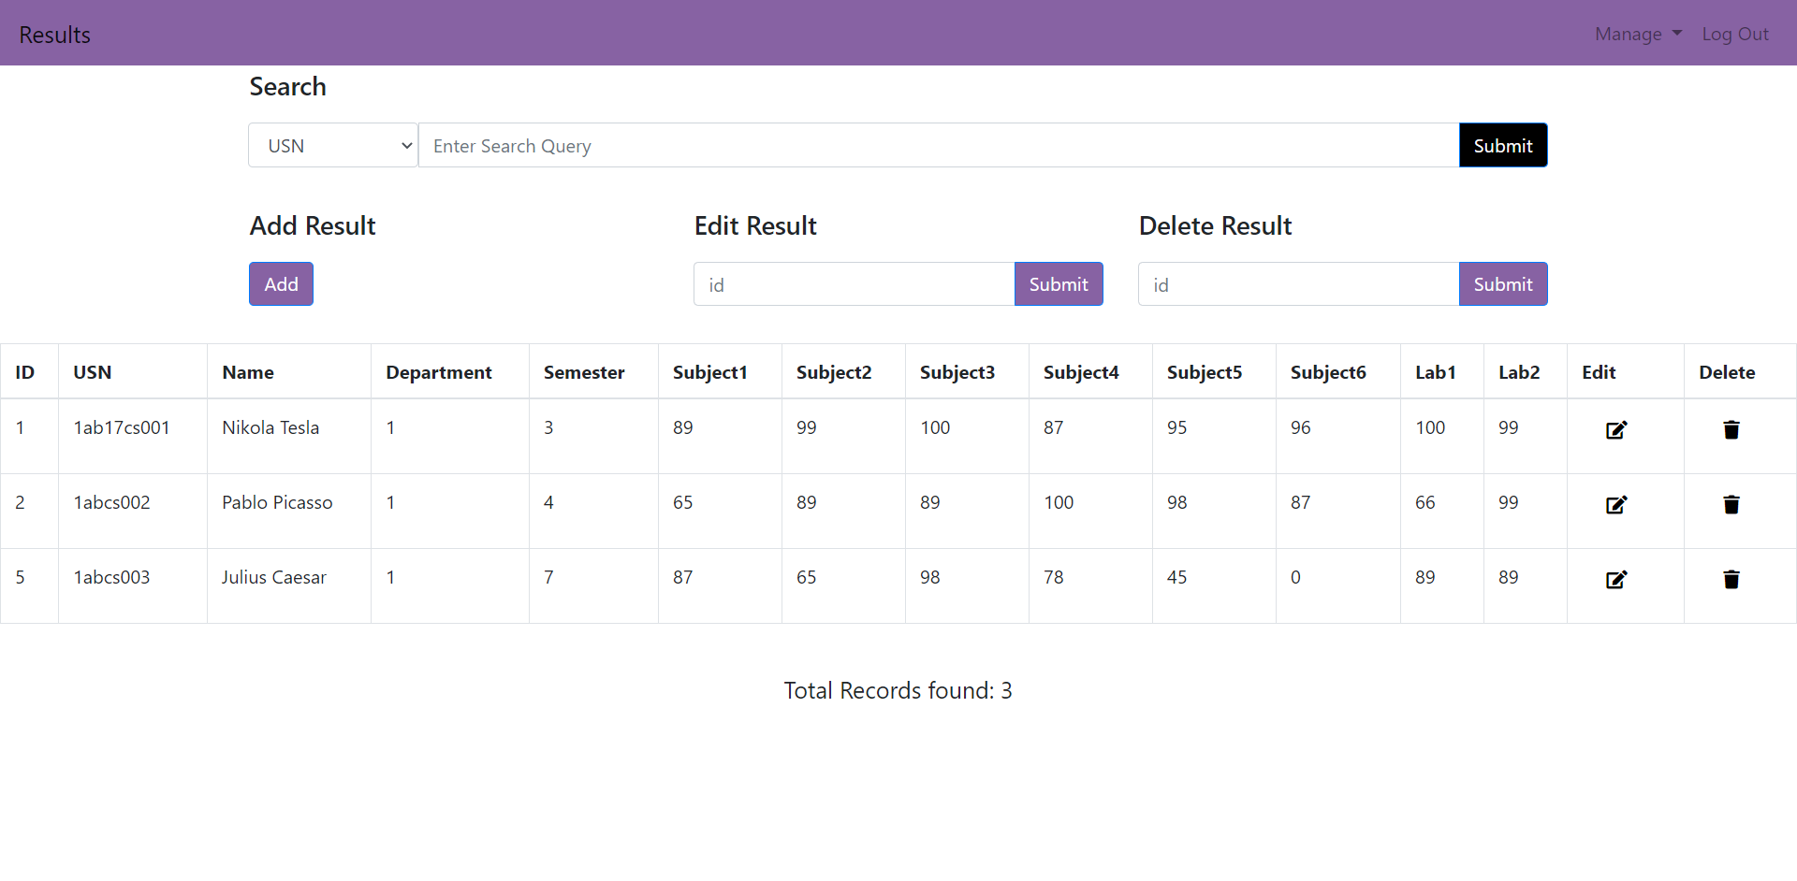

Slide 14

DEMONSTRATION OF THE WEB APP :
14

Slide 15



THANK YOU
JUVAIRIYA FATHIMA
SWARNA A
1RL17CS043 , 7th Sem CSE
1RL17CS043 , 7th Sem CSE
jelonmusk@gmail.com
swarna8722@gmail.com
jelonmusk.github.io

